Slide 1
God’s Prophetic Timeline
A Call For Awakening
Ludwig
13/11/2016

Slide 2
Acts 3:18-21
¹⁸ But those things which God foretold by the mouth of all His prophets, that the Christ would suffer, He has thus fulfilled.
¹⁹ Repent therefore and be converted, that your sins may be blotted out, so that times of refreshing may come from the presence of the Lord,

Slide 3
²⁰ and that He may send Jesus Christ, who was preached to you before,
²¹ whom heaven must receive until the times of restoration of all things, which God has spoken by the mouth of all His holy prophets since the world began.

Slide 4
“Seventy weeks are determined
For your people and for your holy city,
To finish the transgression,
To make an end of sins,
To make reconciliation for iniquity,
To bring in everlasting righteousness,
To seal up vision and prophecy,
And to anoint the Most Holy.

Slide 5
²⁵ “Know therefore and understand,
That from the going forth of
the command
To restore and build Jerusalem
Until Messiah the Prince,
There shall be seven weeks and
sixty-two weeks;
The street shall be built again, and the wall,
Even in troublesome times.

Slide 6
²⁶ “And after the sixty-two weeks
Messiah shall be cut off, but not for Himself;
And the people of the prince who is to come
Shall destroy the city and the sanctuary.
The end of it shall be with a flood,
And till the end of the war desolations are determined.

Slide 7
²⁷ Then he shall confirm a covenant with many for one week;
But in the middle of the week
He shall bring an end to sacrifice
and offering.
And on the wing of abominations shall be one who makes desolate,
Even until the consummation, which is determined,
Is poured out on the desolate.”

Slide 8

70 Weeks
WEEKS simply means SEVEN
Israel were very familiar with the concept of weeks/Sevens especially in the Feasts of the Lord

Slide 9
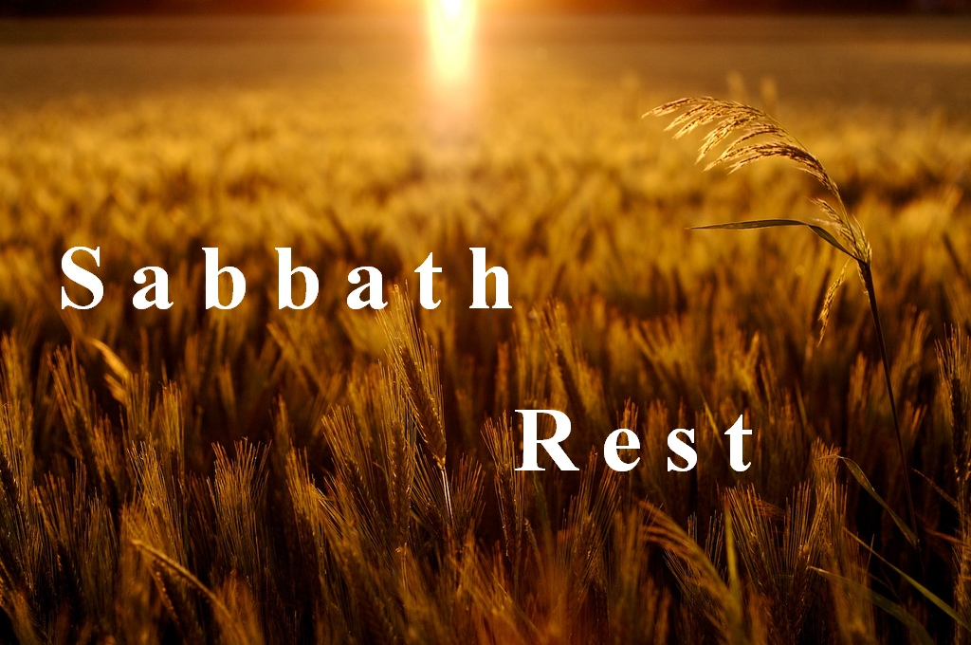
Week of Days
Sabbath – Work 6 days and rest on the Seventh Day

Slide 10

Week of Weeks
Feast of Pentecost/Weeks
The day of Pentecost was a day after the 7th Sabbath
1 X Sabbath = 7th day
7 X Sabbaths = (7 X 7days) = 49th Day
[or 7 Weeks]
THAT IS THE 50th DAY

Slide 11
Week of Years
The Land had to rest every 7th Year
This is known as the Sabbath of the 7th year
The Babylon Captivity was a result of failing to keep the Sabbath every 7th year over 490 years = 70 Sabbaths or 70 years.
For every Sabbath they violated, the land would be desolate for that period of time.
Hence the captivity lasted 70 Years

Slide 12

70 WEEKS in the Book of DANIEL
70 WEEKS = 70 SEVENS
THE SEVENS are SEVEN of Years
70 WEEKS = 70 X 7years = 490 Years

Slide 13
1st
COMING
2nd
COMING
FROM
BC457
Decree
Cyrus
Restore
Rebuilt
City
Sanctuary
BC408
Malachi
3½
Yrs
Is 58:12
70
Yrs
49
Yrs
434
Yrs
Crucified for our sins, transgressions
Messiah cut off
Makes reconciliation
Midst of the week
Cause sacrifice & oblation to cease
3½
Yrs
1000
Yrs
NEW
HEAVENS
&
NEW
EARTH
49 Years
434 Years
3 ½ Years
The Church Age – 2000 years
1000 Years
49 Years
434 Years
3 ½ Years
3 ½ Years
1000 Years
3 ½ Years
Babylonian
Captivity
Restoration
Prophets
“The Silent Years”
Prophets
7
WKS
Overspreading
of
Abominations
62
WKS
½
WK
½
WK
69 Weeks
+
1 Week
= 70 Weeks

Slide 14
1st
COMING
2nd
COMING
The Church Age
2000 years
3½
Years
3½
Years
1000 Years
1000 Years
½
WEEK
Overspreading
of
Abominations
½
WEEK
1 Week (70th WEEK)

Slide 15
Daniel 9:27
²⁷ Then he shall confirm a covenant with many for one week;
But in the middle of the week
He shall bring an end to sacrifice
and offering.
3½
Years
3½
Years
1000 Years
1000 Years
½
WEEK
½
WEEK

Slide 16
1st
COMING
2nd
COMING
The Church Age
2000 years
3½
Years
3½
Years
1000 Years
1000 Years
½
WEEK
Overspreading
of
Abominations
½
WEEK
1 Week (70th WEEK)

Slide 17
Daniel 9:27
And on the wing of abominations shall be
one who makes desolate,
Even until the consummation, which is
determined,
Is poured out on the desolate.”
Rejection of the Blood of Jesus
(Sacrifice)
God’s Wrath Poured out of the 7
Bowls during the 3 ½ years of
Great Tribulation
End or Finish of Something

Slide 18
1st
COMING
2nd
COMING
Overspreading
of
Abominations
3½
Years
------
½
WEEK
3½
Years
------
½
WEEK
The Church Age
2000 years
1000 Years
1000 Years
To finish the transgression
To make an end of sins
To make reconciliation for iniquity
To bring in everlasting
righteousness,
To seal up vision and
prophecy,
To anoint the Most Holy

Slide 19
Acts 3:18-21
¹⁸ But those things which God foretold by the mouth of all His prophets, that the Christ would suffer, He has thus fulfilled.
¹⁹ Repent therefore and be converted, that your sins may be blotted out, so that times of refreshing may come from the presence of the Lord,

Slide 20
RESTORATION
²⁰ and that He may send Jesus Christ, who was preached to you before,
²¹ whom heaven must receive until the times of restoration of all things, which God has spoken by the mouth of all His holy prophets since the world began.

Slide 21
Rev 10:5-7
⁵ The angel whom I saw standing on the sea and on the land raised up his hand to heaven
⁶ and swore by Him who lives forever and ever, who created heaven and the things that are in it, the earth and the things that are in it, and the sea and the things that are in it, that there should be delay no longer,
⁷ but in the days of the sounding of the seventh angel, when he is about to sound, the mystery of God would be finished, as He declared to His servants the prophets.

Slide 22
The Seventh Trumpet
Begin to Sound
The mystery of God would be finished
Christ in You the hope of Glory – Revealing of the sons
Mystery of Christ and the Church
Days of the sounding of the seventh angel covers
3 ½ years of Great Tribulation
Finishes Sounding
Second Coming of Jesus
The Kingdom of this world becomes the kingdom of our Lord and His Christ

Slide 23
Rev 11:15
¹⁵ Then the seventh angel sounded: And there were loud voices in heaven, saying, “The kingdoms of this world have become the kingdoms of our Lord and of His Christ, and He shall reign forever and ever!”

Slide 24
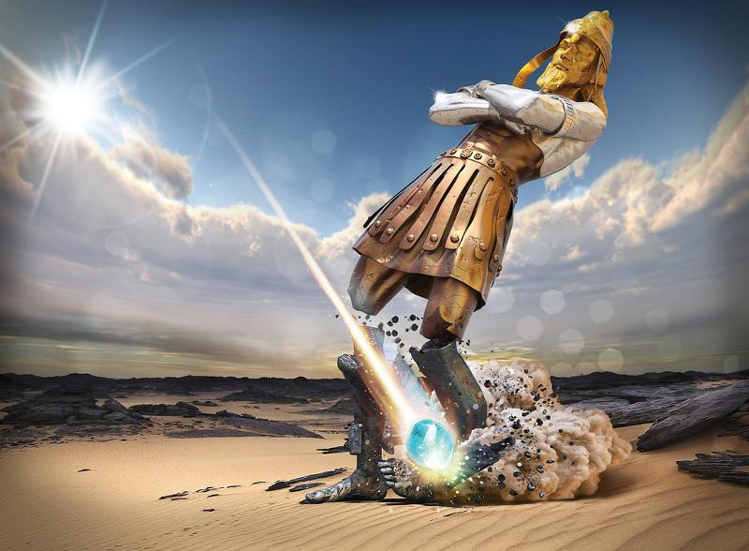

Slide 25
During the 3 ½ Years
Outpouring of God’s wrath over the earth (Seven Bowls)
Satan cast the the earth
The Anti-Christ will reign for 3½ years
Outer-Court Christians will be trampled under foot
Money will fail
The True Church will be taken out and protected
The False/Harlot Church will be destroyed by the Anti-Christal System.

Slide 26
1st
COMING
2nd
COMING
The Church Age
2000 years
3½
Years
3½
Years
1000 Years
1000 Years
½
WEEK
Jesus is Building His Church
½
WEEK
1 Week (70th WEEK)

Slide 27
For The Church
Now Until the Seventh Trumpet
Jesus is building His Church
A time for True Shepherds to rise
A time of equipping through the five-fold ministry
Ephesians 4:1-13 to the measure of the stature of the fullness of Christ
Restoration of the Church unto perfection (Hebrews 6:1-2, Eph 5:26-27)

Slide 28
Conclusion
We must be Awakened
Eph 5:14; 1 Thess 5:5-8,
We must be Alert
Eph 5:15-16
We must Arise

